Slide 1
Learning with Hidden Information
Hung-yi Lee
Notes:
Cuttgin plane and gradient decent, which one is faster!

Slide 2



Different Kinds of Learning
Supervised Learning
Data: $\left\{\left(x^{1},{\hat{y}}^{1}\right),\left(x^{2},{\hat{y}}^{2}\right),⋯\right\}$
Semi-supervised Learning
Data: $\left\{\left(x^{1},{\hat{y}}^{1}\right),\left(x^{2},{\hat{y}}^{2}\right),⋯,\left(x^{N+1},?\right),\left(x^{N+2},? \right)⋯\right\}$
Unsupervised Learning
Data: $\left\{\left(x^{1},?\right),\left(x^{2},?\right),⋯\right\}$
Hidden variable learning
Data: $\left\{\left(x^{1},{\hat{y}}^{1}\right),\left(x^{2},{\hat{y}}^{2}\right),⋯\right\}$
Some useful information is hidden.
$$h^{1}$$
$$h^{2}$$
Notes:
Expensive to label
And hard to judge
Helpful in training, helpful in testing

Slide 3
Outline
Example Applications for Hidden Variable Learning
Structured SVM with Hidden Information
Verifying the correctness
General Framework
EM in one slide
Notes:
Object Detection as example

Slide 4
Example Applications for Hidden Variable Learning

Slide 5







Example Applications
Sentiment Analysis: Automatically identify a movie review is positive or negative
Collecting documents about reviewing movies
看了這部電影覺得很高興 …….
$${\hat{y}}^{1}:$$
Positive (正雷)
$$x^{1}:$$
$$x^{2}:$$
這部電影太糟了
…….
$${\hat{y}}^{2}:$$
Negative (負雷)
$$x^{3}:$$
這部電影很棒 …….
$${\hat{y}}^{3}:$$
Positive (正雷)
This is only an ideal case.
Notes:
Sentiments: 意見、感想
A. Yessenalina, Y. Yue, and C. Cardie, Multi-level Structured Models for Document-level Sentiment Classification, In Proceedings of EMNLP, 2010

Slide 6
Example Applications
Sentiment Analysis: Automatically identify a movie review is positive or negative
Filter out the irrelevant part
我很高興可以跟鄉民分享我的心得
……..
我覺得這部電影太糟了
……..
我很高興可以跟鄉民分享我的心得
……..
我覺得這部電影太糟了
……..
Negative (負雷)
Only part of the document is related to movie review
Which parts are related to movie is hidden information.
Notes:
Sentiments: 意見、感想
A. Yessenalina, Y. Yue, and C. Cardie, Multi-level Structured Models for Document-level Sentiment Classification, In Proceedings of EMNLP, 2010

Slide 7
Example Applications
Summarization: Given a long document, select a set of sentences to form a compact version
Text document
Lecture Recording
sentence
…
paragraph
paragraph
paragraph
Select the whole paragraphs to make readable summaries
For speech, the paragraph boundaries are hidden.

Slide 8

Example Applications
Speech Recognition
The training data in your homework …
Phoneme or state of each frame is given.
x:
y:
a
a
a
b
b
c
c
c
d
d
d
e
e
e
e
Notes:
Acoustic features

Slide 9
Example Applications
DNN
Speech Recognition
Alignment
In the real world …
x:
y:
a
b
c
d
e
The alignment between phonemes/states and acoustic features is hidden.
Notes:
Acoustic features

Slide 10
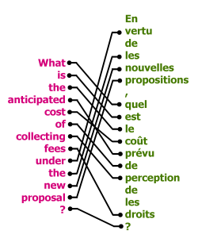
Example Applications
Machine Translation
The word alignment of the sentence pairs is hidden.
https://buffy.eecs.berkeley.edu/PHP/resabs/resabs.php?f_year=2006&f_submit=chapgrp&f_chapter=12
English
French
Notes:
Anticipate = expect
English-French

Slide 11

There is a general framework.
Two Steps,
Three Questions

Slide 12
Two Steps
Step 1: Training
Step2: Inference (Testing)
$$F:X×Y×H→R$$
𝐹:𝑋×𝑌×𝐻→𝑅
$F\left(x,y,h\right)$ evaluate how compatible x, y and h is
𝐹(𝑥,𝑦,ℎ) evaluate how compatible x, y and h is
Find function F
Given object x
$$\tilde{y}=arg\max_{y}{\max_{h}{F\left(x,y,h\right)}}$$
𝑦 ̃=𝑎𝑟𝑔 max_𝑦⁡max_ℎ⁡𝐹(𝑥,𝑦,ℎ)
$$\tilde{y}=arg\max_{y}{\sum_{h}{F\left(x,y,h\right)}}$$
𝑦 ̃=𝑎𝑟𝑔 max_𝑦⁡∑8_ℎ▒𝐹(𝑥,𝑦,ℎ)
Which one is more reasonable?
Notes:
Metaphor of the two ……
比最大 還是 比總合

Slide 13
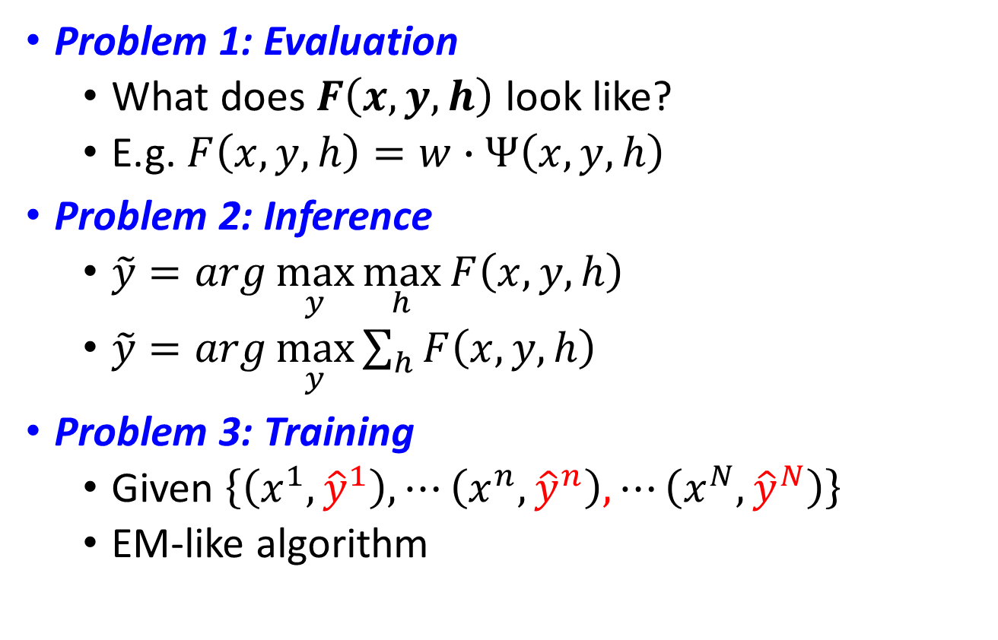
Three Problems
Problem 1: Evaluation
What does $F\left(x,y,h\right)$ look like?
E.g. $F\left(x,y,h\right)=w∙Ψ\left(x,y,h\right)$
Problem 2: Inference
$\tilde{y}=arg\max_{y}{\max_{h}{F\left(x,y,h\right)}}$
$\tilde{y}=arg\max_{y}{\sum_{h}{F\left(x,y,h\right)}}$
Problem 3: Training
Given $\left\{\left(x^{1},{\hat{y}}^{1}\right), ⋯\left(x^{n},{\hat{y}}^{n}\right),⋯\left(x^{N},{\hat{y}}^{N}\right)\right\}$
EM-like algorithm
Notes:
EM is a special case

Slide 14
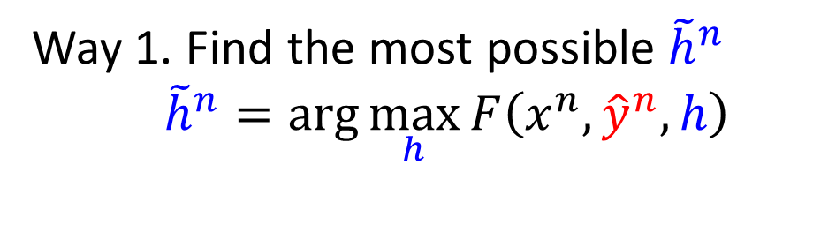
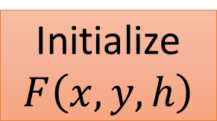
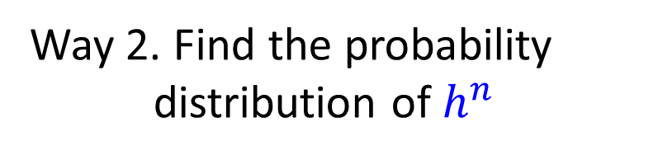
Three Problems - Training
Given Training data: $\left\{\left(x^{1},{\hat{y}}^{1}\right), ⋯\left(x^{n},{\hat{y}}^{n}\right),⋯\left(x^{N},{\hat{y}}^{N}\right)\right\}$
Way 1. Find the most possible ${\tilde{h}}^{n}$
${\tilde{h}}^{n}=arg\max_{h}{F\left(x^{n},{\hat{y}}^{n},h\right)}{ }$
Initialize
$F\left(x,y,h\right)$
Way 2. Find the probability distribution of $h^{n}$
Random?
We have $\left\{\left(x^{1},h^{1},{\hat{y}}^{1}\right), ⋯\left(x^{n},h^{n},{\hat{y}}^{n}\right),⋯\left(x^{N},h^{N},{\hat{y}}^{N}\right)\right\}$
We know how to find $F\left(x,y,h\right)$ at least when it is linear.
Notes:
(cutting plane algorithm)

Slide 15
Structured SVM with Hidden Information
Taking object detection as Example
Notes:
Part 1. Assume we know the type
Two type
Drawback
Solution
Part 2. What if the type is hidden

Slide 16




Motivation
An object can have more than one types
Train
Bicycle
Haruhi
short hair
long hair
Notes:
Treat Short_Hair_Haruhi and Long_Hair_Haruhi as two different kinds of objects
Treat them separately

Slide 17


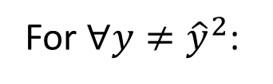



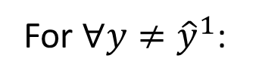


Motivation
$${\hat{y}}^{1}$$
$${\hat{y}}^{2}$$
$$x^{1}$$
$$x^{2}$$
Type1. Short hair
Type 2. Long hair
Original
Training:
For $∀y≠{\hat{y}}^{1}$:
$$w∙φ\left(x^{1},{\hat{y}}^{1}\right)>w∙φ\left(x^{1},y\right)$$
For $∀y≠{\hat{y}}^{2}$:
$$w∙φ\left(x^{2},{\hat{y}}^{2}\right)>w∙φ\left(x^{2},y\right)$$
Because $φ\left(x^{1},{\hat{y}}^{1}\right)$ and $φ\left(x^{2},{\hat{y}}^{2}\right)$ can be very different
It may be hard to use a single w to achieve the above goal

Slide 18
Two Cases
Involving object types into object detection
Case 1
The useful information is available on training data, only hidden in testing data
Not too much difference from original structured SVM, extra efforts for labelling
Case 2
The information is hidden in both training and testing data
What we really care about

Slide 19



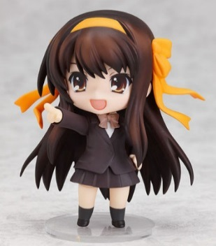

Case 1: Two kinds of Objects?
There are two kinds of objects to be detected: Haruhi_1 and Haruhi_2
Haruhi_1
Haruhi_1
Haruhi_2
Haruhi_2
Haruhi_1
Haruhi_2
Haruhi_1
Haruhi_2
Notes:
Treat Short_Hair_Haruhi and Long_Hair_Haruhi as two different kinds of objects
Treat them separately

Slide 20






Case 1: Two kinds of Objects?
Haruhi_1
Haruhi_2
Evaluation:
Evaluation:
$$F_{1}\left(x,y\right)=w_{1}∙φ\left(x,y\right)$$
$$F_{2}\left(x,y\right)=w_{2}∙φ\left(x,y\right)$$
Training Target:
Training Target:
$$x^{n} is \text{Haruhi}\text{_1}$$
$$x^{n} is \text{Haruhi}\text{_2}$$
$$w_{1}∙φ\left(x^{n},{\hat{y}}^{n}\right)>w_{1}∙φ\left(x^{n},y\right)$$
$$w_{2}∙φ\left(x^{n},{\hat{y}}^{n}\right)>w_{2}∙φ\left(x^{n},y\right)$$
Notes:
Train two different detectors independently

Slide 21

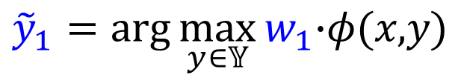

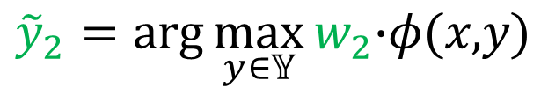
Case 1: Problematic Inference
Now we have $w_{1}$ for Haruhi_1 and $w_{2}$ for Haruhi_2
Inference:
Given an image x
If the Harihu in image is Haruhi_1:
$${\tilde{y}}_{1}=arg\max_{y∈𝕐}{w_{1}\text{∙}φ\text{(}\text{x}\text{,}\text{y}\text{)}}$$
If the Harihu in image is Haruhi_2:
$${\tilde{y}}_{2}=arg\max_{y∈𝕐}{w_{2}\text{∙}φ\text{(}\text{x}\text{,}\text{y}\text{)}}$$
Critical Problem: Given an input image, we do not know the Haruhi in the image is Haruhi_1 or Haruhi_2

Slide 22





Case 1: Problematic Inference
Inference
Input
$$w_{1}∙φ\left( \right)$$
…
If we know its type 1
$$w_{1}∙φ\left( \right)$$
We don’t know the type of the input image actually.
…
$$w_{1}∙φ\left( \right)$$
Notes:
Original approach (without types)

Slide 23



Case 1: Problematic Inference
Inference
Type 1
$$w_{1}∙φ\left( \right)$$
$$w_{2}∙φ\left( \right)$$
…
…
$$w_{1}∙φ\left( \right)$$
$$w_{2}∙φ\left( \right)$$
…
…
$$w_{1}∙φ\left( \right)$$
$$w_{2}∙φ\left( \right)$$
Notes:
Or find the max to complete

Slide 24
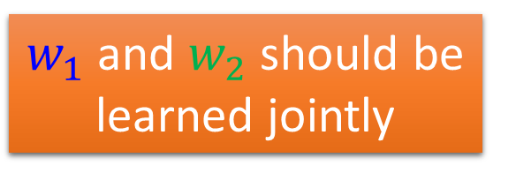









Case 1: Problematic Inference
$w_{1}$ and $w_{2}$ are learned separately
$$x^{n} is \text{Haruhi}\text{_1}$$
Training Target:
$$w_{2}∙φ\left(x^{n},y\right)$$
$$x^{n} is \text{Haruhi}\text{_1}$$
>
$$w_{1}∙φ\left(x^{n},{\hat{y}}^{n}\right)>w_{1}∙φ\left(x^{n},y\right)$$
0.1
0.09
$$w_{1}∙φ\left(x^{n},{\hat{y}}^{n}\right)$$
>
Training Target:
$$w_{1}∙φ\left(x^{n},y\right)$$
$$x^{n} is \text{Haruhi}\text{_2}$$
$$w_{2}∙φ\left(x^{n},{\hat{y}}^{n}\right)>w_{2}∙φ\left(x^{n},y\right)$$
$w_{1}$ and $w_{2}$ should be learned jointly
1000000
999999

Slide 25
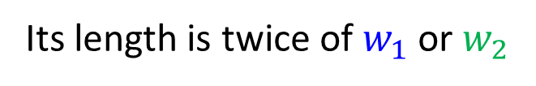

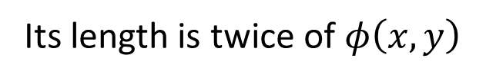

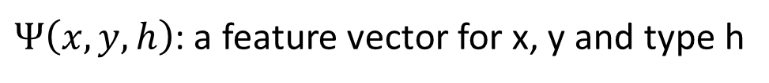

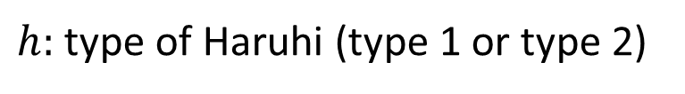

Case 1: Evaluation
For “type 1”,
$$F\left(x,y\right)=w_{1}∙φ\left(x,y\right)$$
For “type 2”,
$$F\left(x,y\right)=w_{2}∙φ\left(x,y\right)$$
=
$$F\left(x,y,h\right)=w∙Ψ\left(x,y,h\right)$$
$h:$ type of Haruhi (type 1 or type 2)
$Ψ\left(x,y,h\right)$: a feature vector for x, y and type h
Its length is twice of $φ\left(x,y\right)$
$w$: a weight vector to be learned
Its length is twice of $w_{1}$ or $w_{2}$

Slide 26
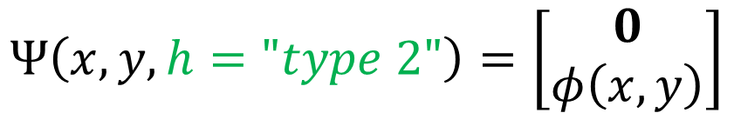

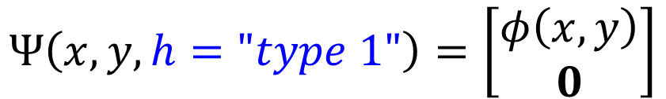

Case 1: Evaluation
$$F\left(x,y,h\right)=w∙Ψ\left(x,y,h\right)$$
$$Ψ\left(x,y,h="type 1"\right)=\left[\begin{aligned}φ\left(x,y\right) \\ 0\end{aligned}\right]$$
$$w=\left[\begin{aligned}w_{1} \\ w_{2}\end{aligned}\right]$$
$$Ψ\left(x,y,h="type 2"\right)=\left[\begin{aligned}0 \\ φ\left(x,y\right)\end{aligned}\right]$$
For “type 1”,
$$F\left(x,y,h\right)=w_{1}∙φ\left(x,y\right)+w_{2}∙0$$
For “type 2”,
$$F\left(x,y,h\right)=w_{1}∙0+w_{2}∙φ\left(x,y\right)$$

Slide 27








Case 1: Inference
$$\tilde{y}=$$
$$arg\max_{y}{\max_{h}{w∙Ψ\left(x,y,h\right)}}$$
Enumerate all possible y
Enumerate all possible y
$$w_{1}∙φ\left( \right)$$
$$w_{2}∙φ\left( \right)$$
Haruhi_1
…
…
$$w_{1}∙φ\left( \right)$$
$$w_{2}∙φ\left( \right)$$
…
…
$$w_{1}∙φ\left( \right)$$
$$w_{2}∙φ\left( \right)$$
…
…
Notes:
It is not different from switch w
Assume short
Assmue long
Byproduct

Slide 28
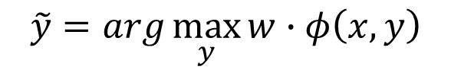

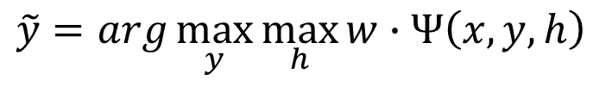
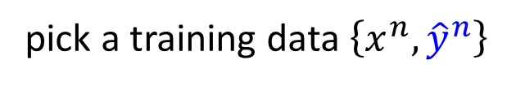
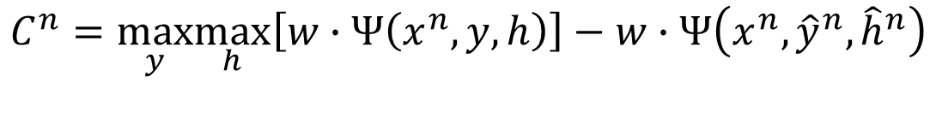
Case 1: Training
$$\tilde{y}=arg\max_{y}{w∙φ\left(x,y\right)}$$
$$C^{n}=\max_{y}\left[w∙φ\left(x^{n},y\right)\right]$$
$$−w∙φ\left(x^{n},{\hat{y}}^{n}\right)$$
$$C^{n}=\max_{y}\left[∆\left({\hat{y}}^{n},y\right)+w∙φ\left(x^{n},y\right)\right]−w∙φ\left(x^{n},{\hat{y}}^{n}\right)$$
$$\tilde{y}=arg\max_{y}{\max_{h}{w∙Ψ\left(x,y,h\right)}}$$
$$C^{n}=\max_{y}\max_{h}\left[w∙Ψ\left(x^{n},y,h\right)\right]−w∙Ψ\left(x^{n},{\hat{y}}^{n},{\hat{h}}^{n}\right)$$
$$C^{n}=\max_{y}\max_{h}\left[∆\left({\hat{y}}^{n},y\right)+w∙Ψ\left(x^{n},y,h\right)\right]−w∙Ψ\left(x^{n},{\hat{y}}^{n},{\hat{h}}^{n}\right)$$

Slide 29


Case 1: Training
$$C^{n}=\max_{y}\left[∆\left({\hat{y}}^{n},y\right)+w∙φ\left(x^{n},y\right)\right]{−w∙φ\left(x^{n},{\hat{y}}^{n}\right)}$$
$$\text{C}\text{n}$$
Notes:
Can you prove lower bound by this?

Slide 30

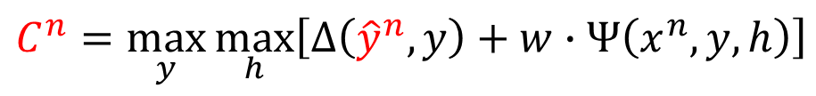
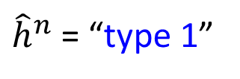
Case 1: Training
$$C^{n}=\max_{y}\max_{h}\left[∆\left({\hat{y}}^{n},y\right)+w∙Ψ\left(x^{n},y,h\right)\right]$$
$$−w∙Ψ\left(x^{n},{\hat{y}}^{n},{\hat{h}}^{n}\right)$$
𝐶^{𝑛}
${\hat{h}}^{n}$ = “type 1”
Notes:
Loser -> DC => you can probably change

Slide 31



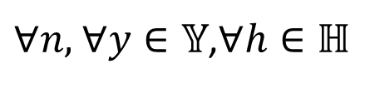

Case 1: Training
Given training data:
$$\left\{\left(x^{1},{\hat{y}}^{1},{\hat{h}}^{1}\right),⋯,\left(x^{n},{\hat{y}}^{n},{\hat{h}}^{n}\right),⋯,\left(x^{N},{\hat{y}}^{N},{\hat{h}}^{N}\right)\right\}$$
$$C^{n}=\max_{y}\max_{h}\left[∆\left({\hat{y}}^{n},y\right)+w∙Ψ\left(x^{n},y,h\right)\right]$$
$$−w∙Ψ\left(x^{n},{\hat{y}}^{n},{\hat{h}}^{n}\right)$$
$$\frac{1}{2}{\left\|w\right\|}^{2}+λ\sum_{n=1}^{N}{ε^{n}}$$
Find $w$, $ε^{1},…,ε^{n},…,ε^{N}$ minimize:
$∀n,$ $∀y∈𝕐$,$∀h∈ℍ$
$$w∙Ψ\left(x^{n},{\hat{y}}^{n},{\hat{h}}^{n}\right)−w∙Ψ\left(x^{n},y,h\right)≥∆\left({\hat{y}}^{n},y\right){−ε^{n}}$$

Slide 32
Case 2: Training with Hidden Information
The useful information are usually hidden
Type 1
Type 1
Type 2
Type 2
Type 1
Type 1
Type 2
Type 2
How to deal with hidden information with Structured SVM?
Notes:
Treat them separately
Miss sth in the next page???

Slide 33









Case 2: Training with Hidden Information
No types? Try to generate ourselves
$$\left(x^{1},{\hat{y}}^{1}\right)$$
$$\left(x^{2},{\hat{y}}^{2}\right)$$
$$\left(x^{3},{\hat{y}}^{3}\right)$$
$$\left(x^{4},{\hat{y}}^{4}\right)$$
Evaluate the compatibility of x, y and h
$$F\left(x,y,h\right)=w∙Ψ\left(x,y,h\right)$$
Random initialized
$$w=w^{0}$$
$$\tilde{h}=arg\max_{h}{w∙Ψ\left(x,\hat{y},h\right) }$$
Given x and $\hat{y}$, find the most compatible h
Notes:
Differen from original inference

Slide 34
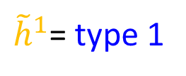
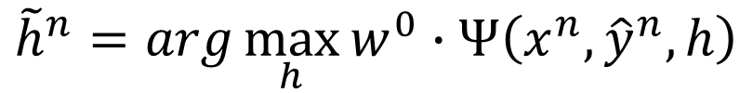

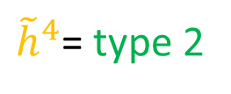
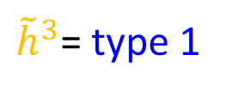
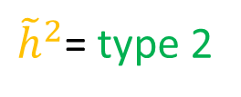
Case 2: Training with Hidden Information
No types? Try to generate ourselves
$$\left(x^{1},{\hat{y}}^{1}\right)$$
$$\left(x^{2},{\hat{y}}^{2}\right)$$
$$\left(x^{3},{\hat{y}}^{3}\right)$$
$$\left(x^{4},{\hat{y}}^{4}\right)$$
${\tilde{h}}^{1}$= type 1
${\tilde{h}}^{2}$= type 2
${\tilde{h}}^{3}$= type 1
${\tilde{h}}^{4}$= type 2
For n = 1, …, 4:
$${\tilde{h}}^{n}=arg\max_{h}{w^{0}∙Ψ\left(x^{n},{\hat{y}}^{n},h\right)}$$
Good guess?
Of course not.
Because $w﷮0$ is random
Notes:
Differen from original inference
The name of type is not important

Slide 35


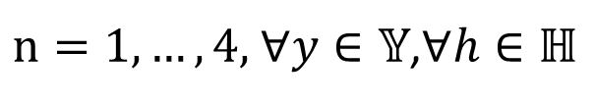
Case 2: Training with Hidden Information
With the types we generate, we can find a w
$$\left(x^{1},{\hat{y}}^{1}\right)$$
$$\left(x^{2},{\hat{y}}^{2}\right)$$
$$\left(x^{3},{\hat{y}}^{3}\right)$$
$$\left(x^{4},{\hat{y}}^{4}\right)$$
${\tilde{h}}^{1}$= type 1
${\tilde{h}}^{2}$= type 2
${\tilde{h}}^{3}$= type 1
${\tilde{h}}^{4}$= type 2
$$\frac{1}{2}{\left\|w\right\|}^{2}+λ\sum_{n=1}^{4}{ε^{n}}$$
Find $w$, $ε^{1},ε^{2},ε^{3},ε^{4}$ minimize:
$n=1,…,4,$ $∀y∈𝕐$,$∀h∈ℍ$
$$w∙Ψ\left(x^{n},{\hat{y}}^{n},{\tilde{h}}^{n}\right)−w∙Ψ\left(x^{n},y,h\right)≥∆\left({\hat{y}}^{n},y\right){−ε^{n}}$$
Notes:
guess the type, then we can train ……
w

Slide 36


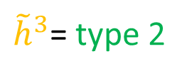

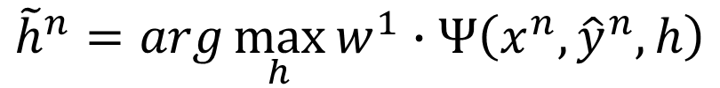
Case 2: Training with Hidden Information
For n = 1, …, 4:
$${\tilde{h}}^{n}=arg\max_{h}{w^{1}∙Ψ\left(x^{n},{\hat{y}}^{n},h\right)}$$
$$\left(x^{1},{\hat{y}}^{1}\right)$$
$$\left(x^{2},{\hat{y}}^{2}\right)$$
$$\left(x^{3},{\hat{y}}^{3}\right)$$
$$\left(x^{4},{\hat{y}}^{4}\right)$$
${\tilde{h}}^{1}$= type 1
${\tilde{h}}^{2}$= type 2
${\tilde{h}}^{3}$= type 2
${\tilde{h}}^{4}$= type 2
${\tilde{h}}^{3}$= type 1
$$w^{1}$$
Solving a QP
Probably not
Is $w^{1}$ a good weight vector?
Train from random $\tilde{h}$

Slide 37
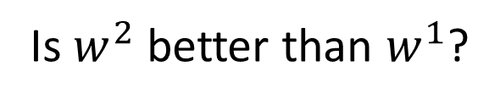
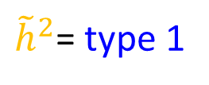
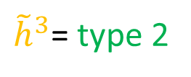
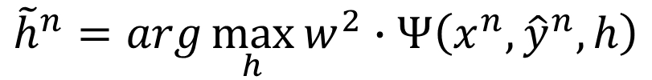

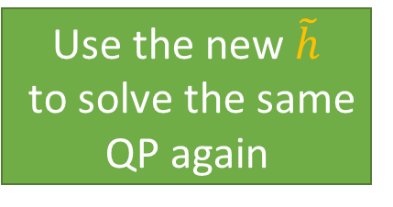
Case 2: Training with Hidden Information
For n = 1, …, 4:
$${\tilde{h}}^{n}=arg\max_{h}{w^{2}∙Ψ\left(x^{n},{\hat{y}}^{n},h\right)}$$
$$\left(x^{1},{\hat{y}}^{1}\right)$$
$$\left(x^{2},{\hat{y}}^{2}\right)$$
$$\left(x^{3},{\hat{y}}^{3}\right)$$
$$\left(x^{4},{\hat{y}}^{4}\right)$$
${\tilde{h}}^{1}$= type 1
${\tilde{h}}^{2}$= type 2
${\tilde{h}}^{3}$= type 2
${\tilde{h}}^{4}$= type 2
${\tilde{h}}^{2}$= type 1
${\tilde{h}}^{3}$= type 1
Use the new $\tilde{h}$
to solve the same QP again
$$w^{2}$$
Solving a QP
Is $w^{2}$ better than $w^{1}$?
Yes
(?)
Iteratively
Notes:
EM?

Slide 38
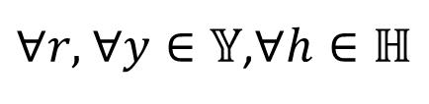
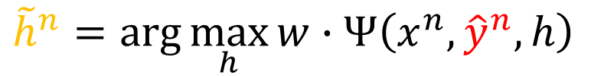


Case 2: Training with Hidden Information
Summary
Iteration in Iteration
Training data: $\left\{\left(x^{1},{\hat{y}}^{1}\right),\left(x^{2},{\hat{y}}^{2}\right),⋯\left(x^{n},{\hat{y}}^{n}\right)⋯\left(x^{N},{\hat{y}}^{N}\right)\right\}$
Initialize
w
$${\tilde{h}}^{n}=arg\max_{h}{w∙Ψ\left(x^{n},{\hat{y}}^{n},h\right)}{ }$$
Cutting Plane Algorithm
$$\frac{1}{2}{\left\|w\right\|}^{2}+λ\sum_{n=1}^{N}{ε^{n}}$$
Find $w$, $ε^{1},⋯,ε^{N}$ minimize
$∀r,$ $∀y∈𝕐$,$∀h∈ℍ$
$$w∙Ψ\left(x^{n},{\hat{y}}^{n},{\tilde{h}}^{n}\right)−w∙Ψ\left(x^{n},y,h\right)≥∆\left({\hat{y}}^{n},y\right){−ε^{n}}$$
Notes:
(cutting plane algorithm)

Slide 39

Why we can get better weight vector after each iteration?
Warning of Math
Notes:
1. The original SVM is convex, the hidden one is cnvex + concave
2. Idea of CCCP

Slide 40

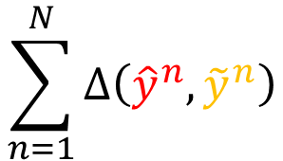
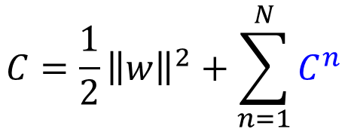

Structured SVM
Training data: $\left\{\left(x^{1},{\hat{y}}^{1}\right), ⋯\left(x^{n},{\hat{y}}^{n}\right)⋯\left(x^{N},{\hat{y}}^{N}\right)\right\}$
Minimizing cost function
$$C=\frac{1}{2}{\left\|w\right\|}^{2}+\sum_{n=1}^{N}{C^{n}}$$
$$\sum_{n=1}^{N}{∆\left({\hat{y}}^{n},{\tilde{y}}^{n}\right)}$$
$$≥$$
$$C^{n}≥∆\left({\hat{y}}^{n},{\tilde{y}}^{n}\right)$$
$$C^{n}=\max_{y}\left[∆\left({\hat{y}}^{n},y\right)+w∙φ\left(x^{n},y\right)\right]{−w∙φ\left(x^{n},{\hat{y}}^{n}\right)}$$
What does the function C^{n} look like?
Notes:
Can formulated as QP similar to SVM

Slide 41

Structured SVM
$$C^{n}=\max_{y}\left[∆\left({\hat{y}}^{n},y\right)+w∙φ\left(x^{n},y\right)\right]{−w∙φ\left(x^{n},{\hat{y}}^{n}\right)}$$
convex
$$∆\left({\hat{y}}^{n},y^{′} \right)+w∙φ\left(x^{n},\text{y}\text{′}\right)$$
$$∆\left({\hat{y}}^{n},y^{′′}\right)+w∙φ\left(x^{n},y^{′′}\right)$$
Notes:
How to explain this???????????????

Slide 42
Structured SVM
$$C^{n}=\max_{y}\left[∆\left({\hat{y}}^{n},y\right)+w∙φ\left(x^{n},y\right)\right]{−w∙φ\left(x^{n},{\hat{y}}^{n}\right)}$$
convex
Notes:
How to explain this???

Slide 43
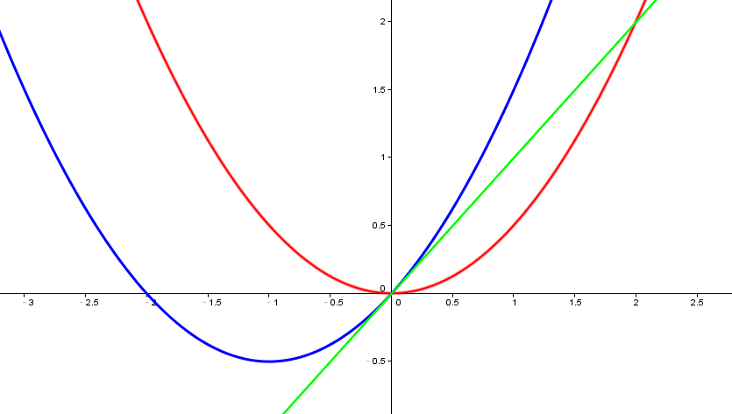
Structured SVM
convex
$$C^{n}=\max_{y}\left[∆\left({\hat{y}}^{n},y\right)+w∙φ\left(x^{n},y\right)\right]{−w∙φ\left(x^{n},{\hat{y}}^{n}\right)}$$
convex
line
convex
convex
line

Slide 44
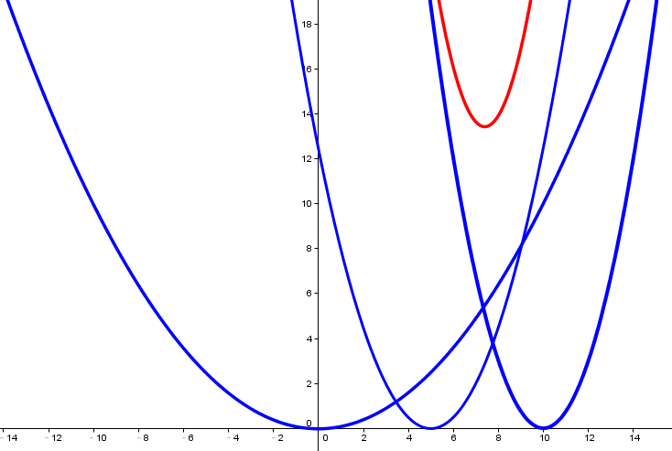


Structured SVM
convex
$$C=\frac{1}{2}{\left\|w\right\|}^{2}+\sum_{n=1}^{N}{C^{n}}$$
convex
convex
Notes:
Init is not important

Slide 45






Structured SVM with Hidden Information
Minimizing cost function
$$C=\frac{1}{2}{\left\|w\right\|}^{2}+\sum_{n=1}^{N}{C^{n}}$$
$$\sum_{n=1}^{N}{∆\left({\hat{y}}^{n},{\tilde{y}}^{n}\right)}$$
$$≥$$
$$C^{n}≥∆\left({\hat{y}}^{n},{\tilde{y}}^{n}\right)$$
$$C^{n}=\max_{y}\max_{h}\left[∆\left({\hat{y}}^{n},y\right)+w∙Ψ\left(x^{n},y,h\right)\right]$$
$$−\max_{h}{w∙Ψ\left(x^{n},{\hat{y}}^{n},h\right)}$$
Notes:
http://www.stat.ucla.edu/~yuille/pubs/optimize_papers/cccp_nips01.pdf
Ｓｃｉ
Any intuitive exaplanation

Slide 46

Structured SVM with Hidden Information
$$C^{n}=\max_{y}\max_{h}\left[∆\left({\hat{y}}^{n},y\right)+w∙Ψ\left(x^{n},y,h\right)\right]$$
$$−\max_{h}{w∙Ψ\left(x^{n},{\hat{y}}^{n},h\right)}$$
𝐶^{𝑛}
h = “type 1”
h = “type 2”
Notes:
Loser -> DC => you can probably change

Slide 47


Structured SVM with Hidden Information
Cost function to be minimized
$$C^{n}=\max_{y}\max_{h}\left[∆\left({\hat{y}}^{n},y\right)+w∙Ψ\left(x^{n},y,h\right)\right]$$
$$−\max_{h}{w∙Ψ\left(x^{n},{\hat{y}}^{n},h\right)}$$
convex
convex
Notes:
http://www.stat.ucla.edu/~yuille/pubs/optimize_papers/cccp_nips01.pdf

Slide 48



Structured SVM with Hidden Information
Cost function to be minimized
$$C^{n}=\max_{y}\max_{h}\left[∆\left({\hat{y}}^{n},y\right)+w∙Ψ\left(x^{n},y,h\right)\right]$$
$$−\max_{h}{w∙Ψ\left(x^{n},{\hat{y}}^{n},h\right)}$$
convex
concave
?
+
=
Notes:
http://www.stat.ucla.edu/~yuille/pubs/optimize_papers/cccp_nips01.pdf

Slide 49










$$C^{n}=\max_{y}\max_{h}\left[∆\left({\hat{y}}^{n},y\right)+w∙Ψ\left(x^{n},y,h\right)\right]$$
$$−\max_{h}{w∙Ψ\left(x^{n},{\hat{y}}^{n},h\right)}$$
convex
concave
Auxiliary function $A\left(w\right)$ at w⁰:
Minimum value of $A\left(w\right)$ is at w¹
1.$A\left(w^{0}\right)=C^{n}\left(w^{0}\right)$
$$C^{n}\left(w\right)$$
2. Upper bound of $C^{n}\left(w\right)$
$$A\left(w^{1}\right)<A\left(w^{0}\right)$$
3. Easy to be minimized
$$C^{n}\left(w^{1}\right)<A\left(w^{1}\right)$$
$${C^{n}\left(w^{1}\right)<C}^{n}\left(w^{0}\right)$$
w
w¹
w⁰
Notes:
Of course , gradient descent can be used, but we have a better way here.
What is Different from gradient?

Slide 50









$$C^{n}=\max_{y}\max_{h}\left[∆\left({\hat{y}}^{n},y\right)+w∙Ψ\left(x^{n},y,h\right)\right]$$
$$−\max_{h}{w∙Ψ\left(x^{n},{\hat{y}}^{n},h\right)}$$
convex
concave
Another auxiliary function $A\left(w\right)$ at w¹:
Minimum value of $A\left(w\right)$ is at w²
1. $A\left(w^{1}\right)=C^{n}\left(w^{1}\right)$
$$C^{n}\left(w\right)$$
2. Upper bound of $C^{n}\left(w\right)$
$$A\left(w^{2}\right)<A\left(w^{1}\right)$$
3. Easy to be minimized
$$C^{n}\left(w^{2}\right)<A\left(w^{2}\right)$$
$${C^{n}\left(w^{2}\right) <C}^{n}\left(w^{1}\right)$$
Find a w that can make $C^{n}\left(w\right)$
smaller at each iteration
Can only reach local minimum
w
w²
w¹
w⁰
Notes:
Different from gradient!

Slide 51







$$C^{n}=\max_{y}\max_{h}\left[∆\left({\hat{y}}^{n},y\right)+w∙Ψ\left(x^{n},y,h\right)\right]$$
$$−\max_{h}{w∙Ψ\left(x^{n},{\hat{y}}^{n},h\right)}$$
convex
concave
+
$$w$$
$$w$$
=
w⁰
Auxiliary function $A\left(w\right)$ at w⁰:
$C^{n}\left(w\right)$
1. $A\left(w^{0}\right)=C^{n}\left(w^{0}\right)$
2. Upper bound of $C^{n}\left(w\right)$
3. Easy to be minimized
convex
$$w$$
w⁰
Notes:
Find a peach iteration
Converge at local minimum

Slide 52


What is the relation to the EM-like process?
$${\tilde{h}}^{n}=arg\max_{h}{w∙Ψ\left(x^{n},{\hat{y}}^{n},h\right)}$$
$$w$$
to form the auxiliary function
find the minimum value
Solving a QP
After each iteration, the w obtained decrease the cost function
$$w$$

Slide 53







$${\tilde{h}}^{n}=arg\max_{h}{w∙Ψ\left(x^{n},{\hat{y}}^{n},h\right)}$$
w⁰
$$w$$
to form the auxiliary function
$$C^{n}=\max_{y}\max_{h}\left[∆\left({\hat{y}}^{n},y\right)+w∙Ψ\left(x^{n},y,h\right)\right]$$
$$−\max_{h}{w∙Ψ\left(x^{n},{\hat{y}}^{n},h\right)}$$
convex
concave
$$w∙Ψ\left(x^{n},{\hat{y}}^{n},h=1\right)$$
$$w∙Ψ\left(x^{n},{\hat{y}}^{n},h=2\right)$$
$$w∙Ψ\left(x^{n},{\hat{y}}^{n},h=1\right)$$
$$w∙Ψ\left(x^{n},{\hat{y}}^{n},h=2\right)$$
$$w$$
Notes:
Find a peach iteration
Converge at local minimum

Slide 54

$${\tilde{h}}^{n}=arg\max_{h}{w∙Ψ\left(x^{n},{\hat{y}}^{n},h\right)}$$
w⁰
$$w$$
to form the auxiliary function
$$C^{n}=\max_{y}\max_{h}\left[∆\left({\hat{y}}^{n},y\right)+w∙Ψ\left(x^{n},y,h\right)\right]$$
$$−\max_{h}{w∙Ψ\left(x^{n},{\hat{y}}^{n},h\right)}$$
convex
concave
$${\tilde{h}}^{n}=arg\max_{h}{w^{0}∙Ψ\left(x^{n},{\hat{y}}^{n},h\right)}$$
$$A\left(w\right)=\max_{y}\max_{h}\left[∆\left({\hat{y}}^{n},y\right)+w∙Ψ\left(x^{n},y,h\right)\right]{−w∙Ψ\left(x^{n},{\hat{y}}^{n},{\tilde{h}}^{n}\right)}$$
Notes:
Find a peach iteration
Converge at local minimum

Slide 55


$$A\left(w\right)=\max_{y}\max_{h}\left[∆\left({\hat{y}}^{n},y\right)+w∙Ψ\left(x^{n},y,h\right)\right]{−w∙Ψ\left(x^{n},{\hat{y}}^{n},{\tilde{h}}^{n}\right)}$$
find the minimum value
Solving a QP
$$w∙Ψ\left(x^{n},{\hat{y}}^{n},{\tilde{h}}^{n}\right)−\max_{y}\max_{h}\left[∆\left({\hat{y}}^{n},y\right)+w∙Ψ\left(x^{n},y,h\right)\right]{=−A^{n}\left(w\right)}$$
$$∀y∈𝕐,∀h∈ℍ$$
$$w∙Ψ\left(x^{n},{\hat{y}}^{n},{\tilde{h}}^{n}\right)−\left[w∙Ψ\left(x^{n},y,h\right)+∆\left({\hat{y}}^{n},y\right)\right]≥−A^{n}\left(w\right)$$
$$∀y∈𝕐,∀h∈ℍ$$
$$w∙Ψ\left(x^{n},{\hat{y}}^{n},{\tilde{h}}^{n}\right)−w∙Ψ\left(x^{n},y,h\right)≥∆\left({\hat{y}}^{n},y\right)−A^{n}\left(w\right)$$
Notes:
Find a peach iteration
Converge at local minimum

Slide 56

End of Warning
Notes:
1. The original SVM is convex, the hidden one is cnvex + concave
2. Idea of CCCP

Slide 57


Structured SVM with Hidden Information
Problem 1: Evaluation
Problem 2: Inference
Problem 3: Training
$$F\left(x,y,h\right)=w∙Ψ\left(x,y,h\right)$$
$$\tilde{y}=arg\max_{y}{\max_{h}{F\left(x,y,h\right)}}$$
EM-like algorithm
Find hidden information
Find model parameters

Slide 58

EM in one slide

Slide 59




EM in one slide
Problem 1: Evaluation
Problem 2: Inference
Problem 3: Training
$$F\left(x,y,h\right)=P\left(x,y,h\right)$$
$$\tilde{y}=arg\max_{y}{\sum_{h}{P\left(x,y,h\right)}}$$
Find hidden information
$$P\left(h|x,y\right)=\frac{P\left(x,y,h\right)}{\sum_{h}{P\left(x,y,h\right)}}$$
Find model parameters
$$P\left(x,y,h\right)=P\left(h|x,y\right)P\left(x,y\right)$$

Slide 60
To Learn More
Framework
Chun-Nam John Yu and Thorsten Joachims, ”Learning Structural SVMs with Latent Variables,” ICML 2009
Video
Wang, Yang, and Greg Mori. "Max-margin hidden conditional random fields for human action recognition," CVPR 2009
Wang, Yang, and Greg Mori. "Hidden part models for human action recognition: Probabilistic versus max margin," Pattern Analysis and Machine Intelligence, IEEE Transactions, 2011
Image
Zhu, Long, et al. "Latent hierarchical structural learning for object detection."Computer Vision and Pattern Recognition (CVPR), 2010 IEEE Conference on. IEEE, 2010.
Felzenszwalb, Pedro F., et al. "Object detection with discriminatively trained part-based models." Pattern Analysis and Machine Intelligence, IEEE Transactions on 32.9 (2010): 1627-1645.
Language processing
Sun, Xu, et al. "Latent Variable Perceptron Algorithm for Structured Classification," IJCAI. Vol. 9. 2009
http://speech.ee.ntu.edu.tw/~tlkagk/courses/MLDS_2015/Structured%20Lecture/Summarization%20Hidden_2.ecm.mp4/index.html

